Slide 1
Introduction to Machine Learning

Slide 2
Why are you here?
What is Machine Learning?
Why are you taking this course?
What topics covered?

Slide 3

Machine Learning is…
Machine learning, a branch of artificial intelligence, concerns the construction and study of systems that can learn from data.

Slide 4
Machine Learning is…
Machine learning is programming computers to optimize a performance criterion using example data or past experience.
-- Ethem Alpaydin
The goal of machine learning is to develop methods that can automatically detect patterns in data, and then to use the uncovered patterns to predict future data or other outcomes of interest.
-- Kevin P. Murphy
The field of pattern recognition is concerned with the automatic discovery of regularities in data through the use of computer algorithms and with the use of these regularities to take actions.
-- Christopher M. Bishop

Slide 5

Machine Learning is…
Machine learning is about predicting the future based on the past.
-- Hal Daume III

Slide 6
Machine Learning is…
Machine learning is about predicting the future based on the past.
-- Hal Daume III
past
future
predict
learn
Training
Data
model/
predictor
Testing
Data
model/
predictor

Slide 7
Machine Learning, aka
data mining: machine learning applied to “databases”, i.e. collections of data
inference and/or estimation in statistics
pattern recognition in engineering
signal processing in electrical engineering
induction
optimization

Slide 8
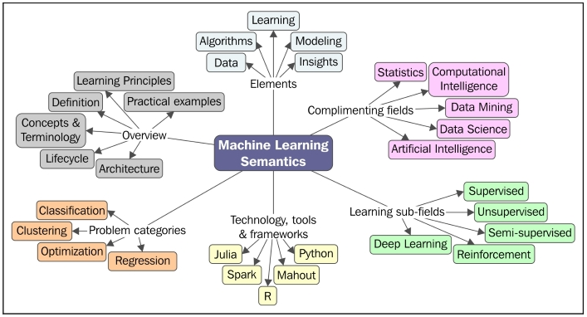

Slide 9
Goals of the course: Learn about…
Different machine learning problems
Common techniques/tools used
theoretical understanding
practical implementation
Dealing with large (huge) data sets
Programming tools

Slide 10
Machine learning problems
What high-level machine learning problems have you seen or heard of before?

Slide 11
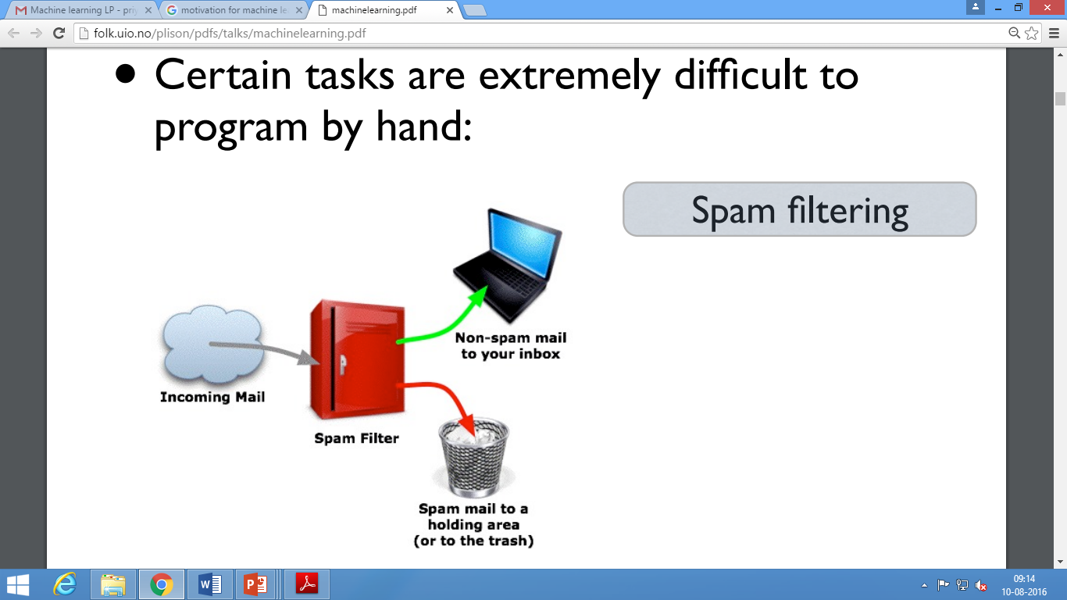

Slide 12


Slide 13
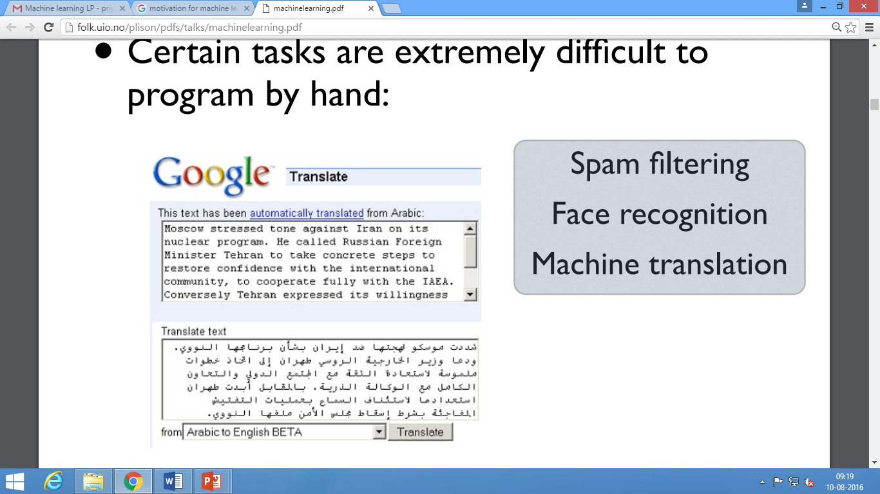

Slide 14
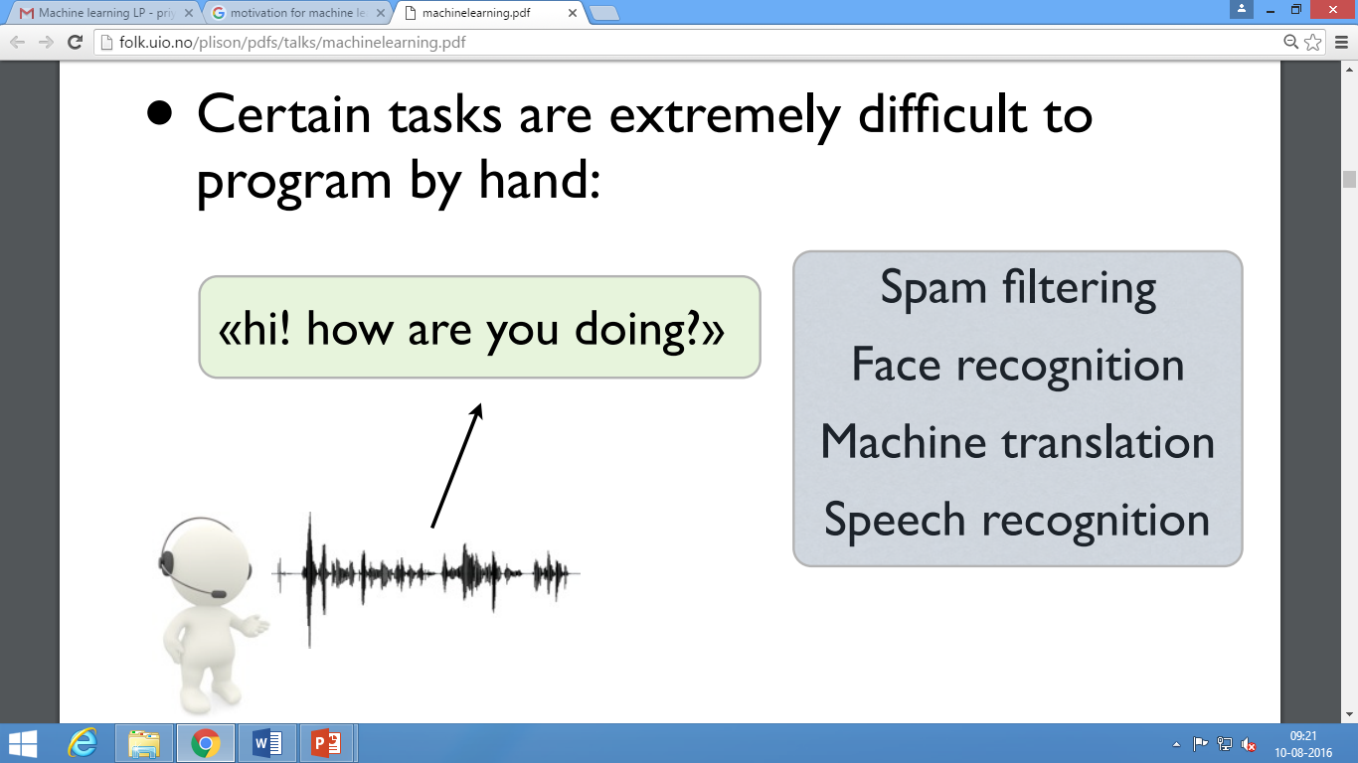

Slide 15
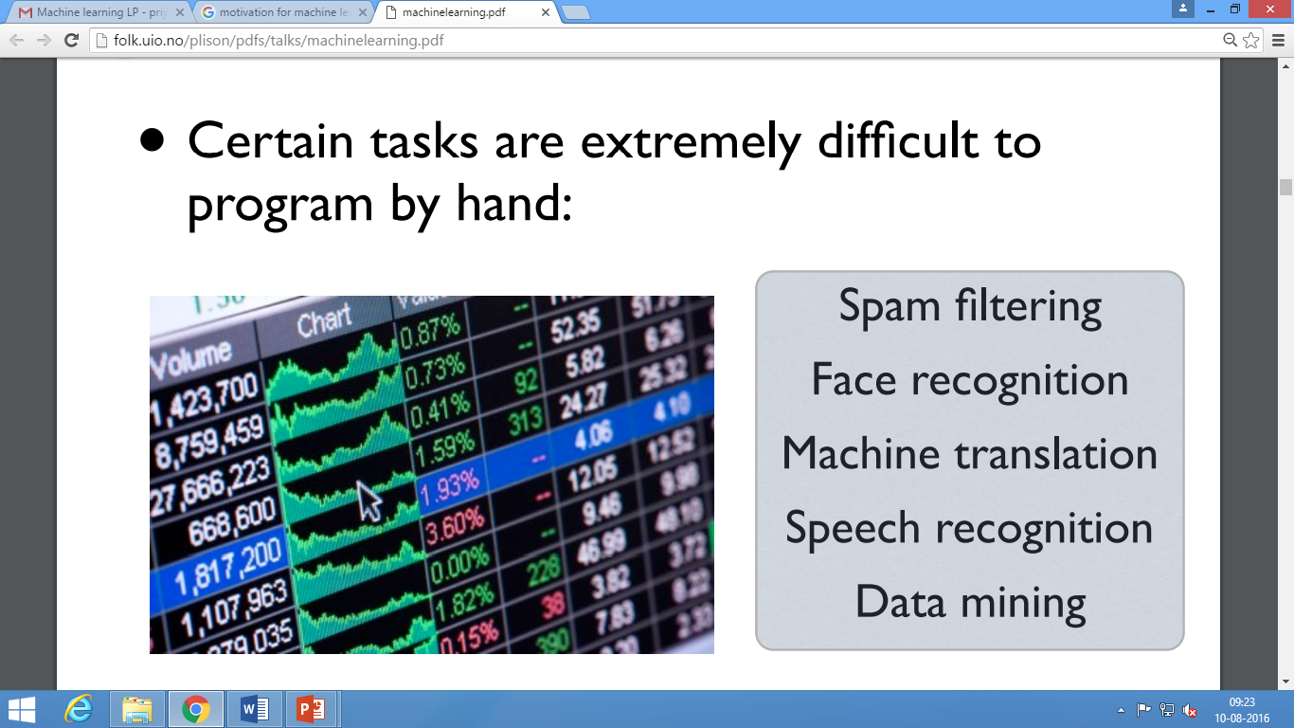

Slide 16
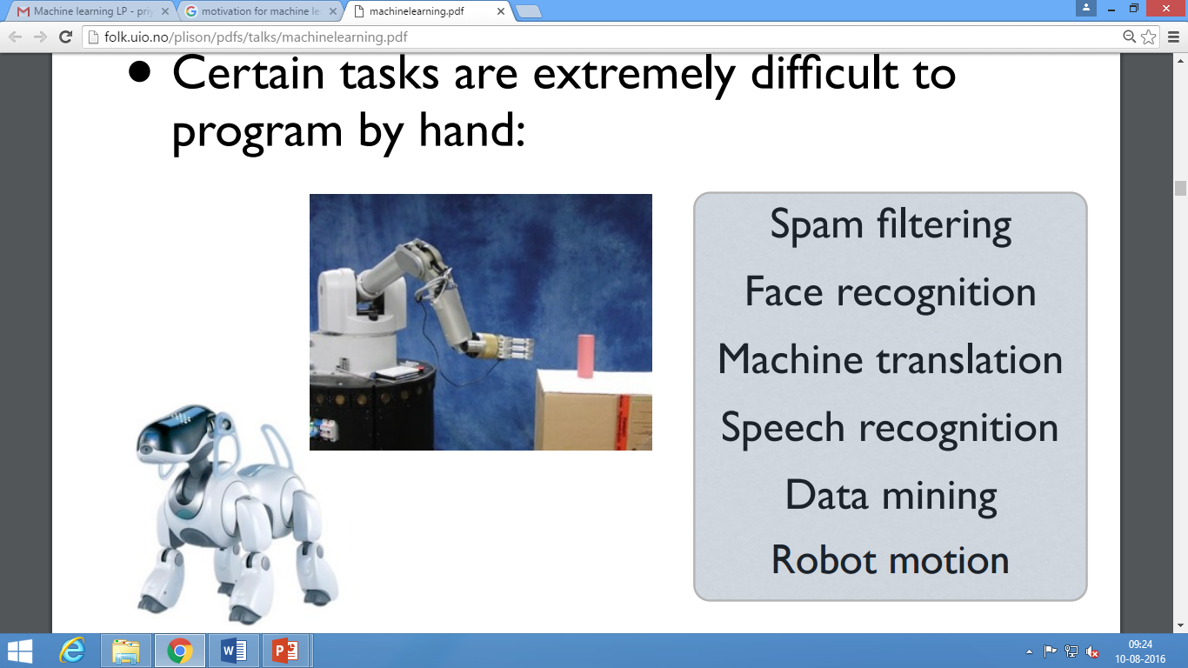

Slide 17
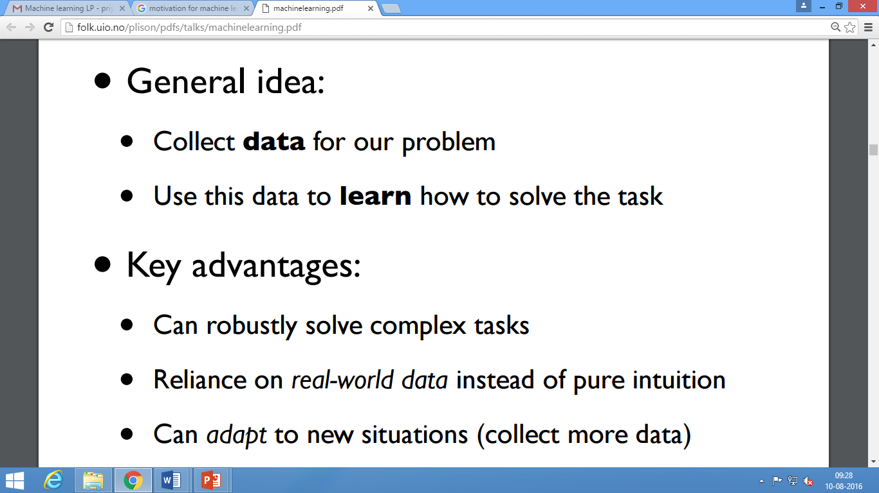

Slide 18
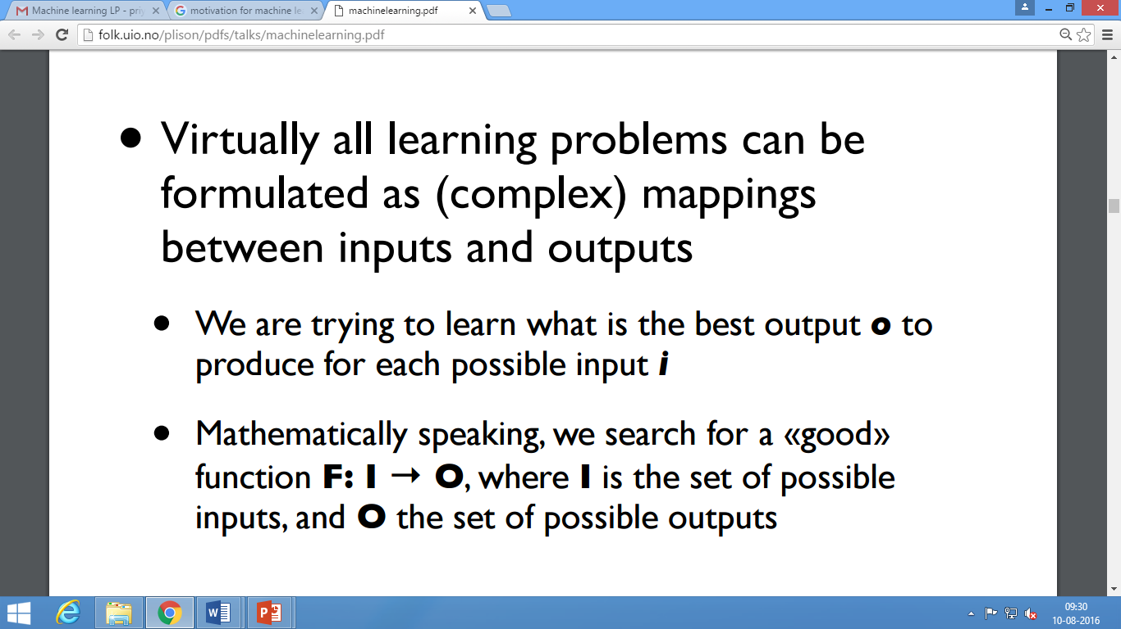

Slide 19
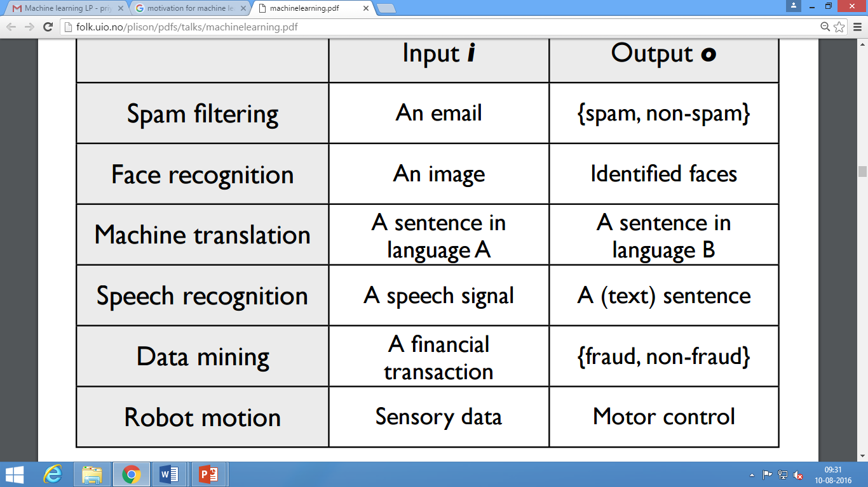

Slide 20
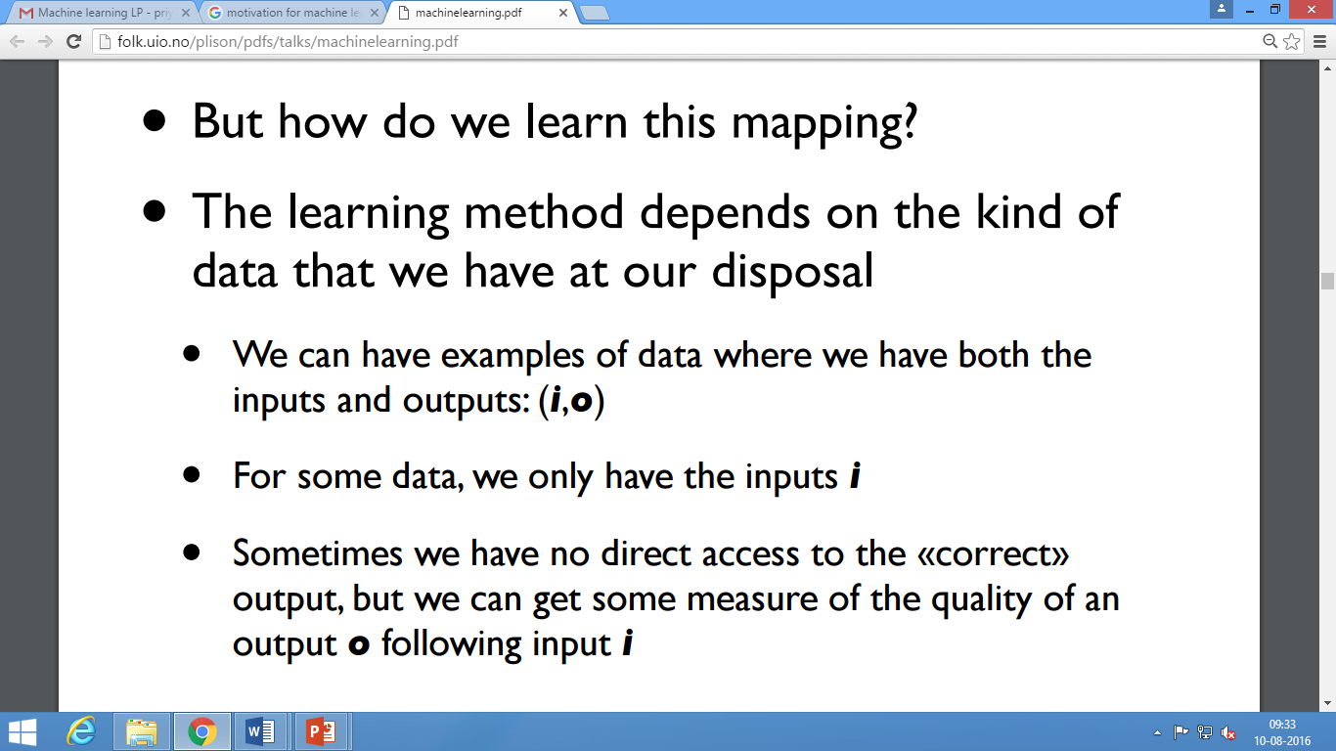

Slide 21
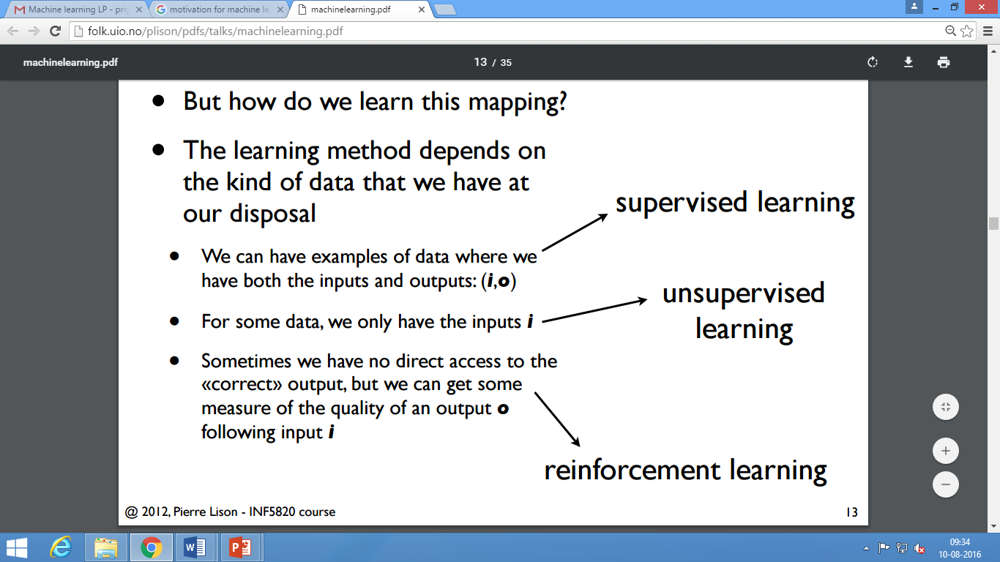

Slide 22
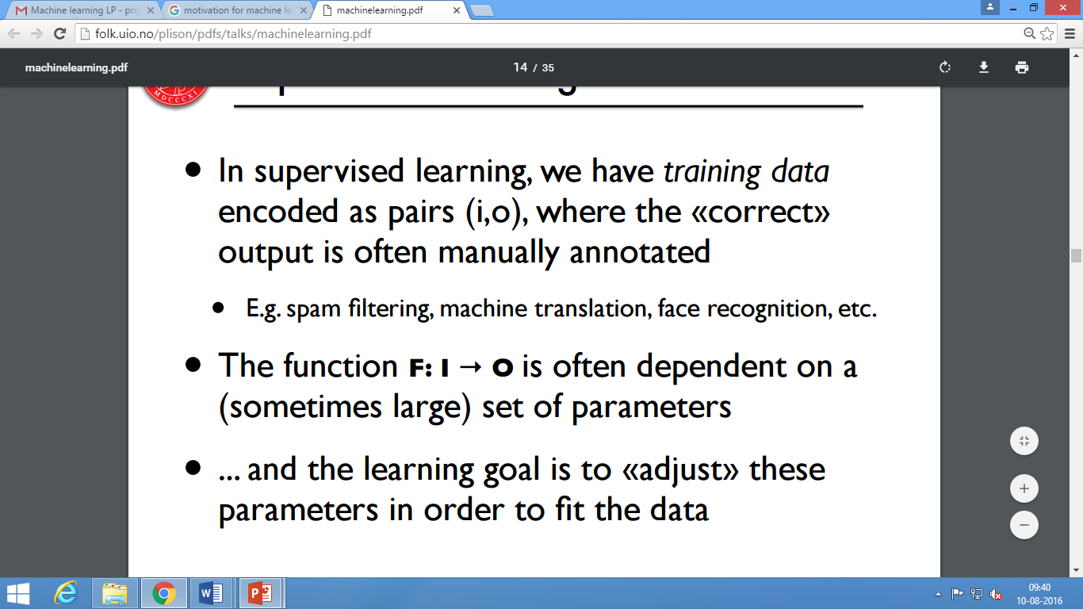

Slide 23

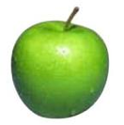


Data
examples
Data

Slide 24
Supervised learning
examples
label
label₁
label₃
labeled examples
label₄
label₅
Supervised learning: given labeled examples

Slide 25
Supervised learning
label
label₁
model/
predictor
label₃
label₄
label₅
Supervised learning: given labeled examples

Slide 26
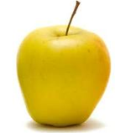
Supervised learning
model/
predictor
predicted label
Supervised learning: learn to predict new example

Slide 27
Supervised learning: classification
label
apple
Classification: a finite set of labels
apple
banana
banana
Supervised learning: given labeled examples

Slide 28
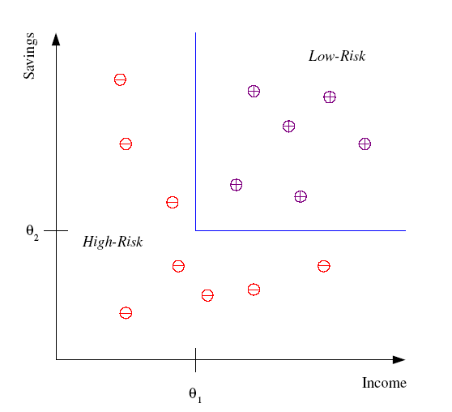
Classification Example
Differentiate between low-risk and high-risk customers from their income and savings

Slide 29
Classification Applications
Face recognition
Character recognition
Spam detection
Medical diagnosis: From symptoms to illnesses
Biometrics: Recognition/authentication using physical and/or behavioral characteristics: Face, iris, signature, etc

Slide 30
Supervised learning: regression
label
-4.5
Regression: label is real-valued
10.1
3.2
4.3
Supervised learning: given labeled examples

Slide 31
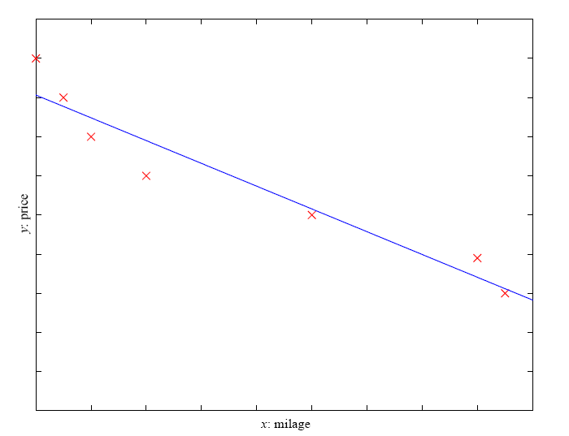
Regression Example
Price of a used car
x : car attributes (e.g. mileage)
y : price
y = wx+w₀

Slide 32
Regression Applications
Economics/Finance: predict the value of a stock
Epidemiology
Car/plane navigation: angle of the steering wheel, acceleration, …
Temporal trends: weather over time

Slide 33
Supervised learning: ranking
label
1
Ranking: label is a ranking
4
2
3
Supervised learning: given labeled examples

Slide 34
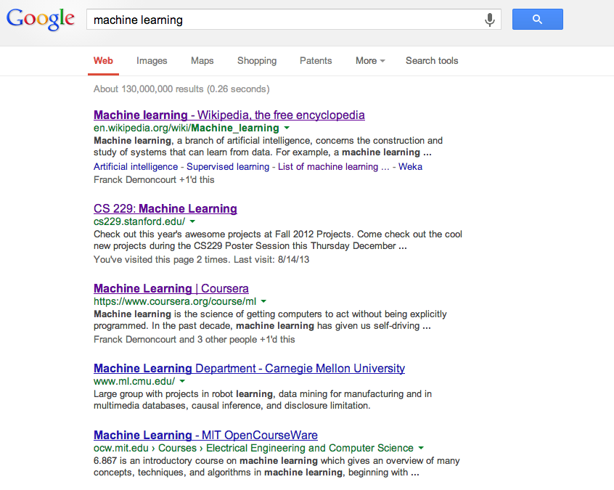
Ranking example
Given a query and
a set of web pages,
rank them according
to relevance

Slide 35
Ranking Applications
User preference, e.g. Netflix “My List” -- movie queue ranking
iTunes
flight search (search in general)
reranking N-best output lists
…

Slide 36
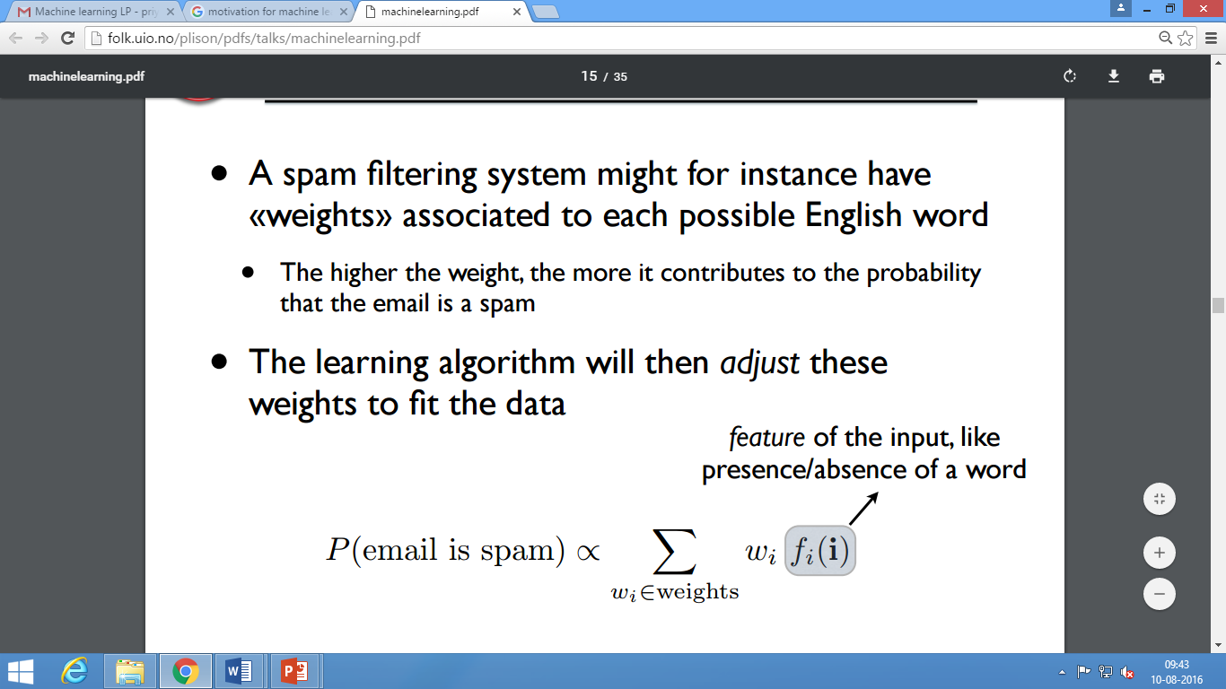

Slide 37
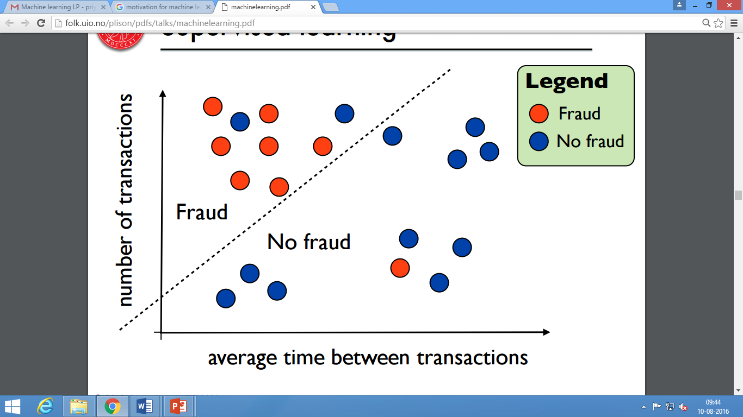

Slide 38
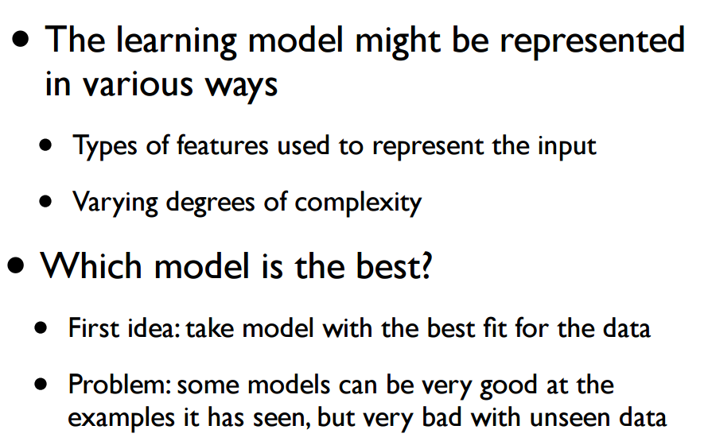

Slide 39
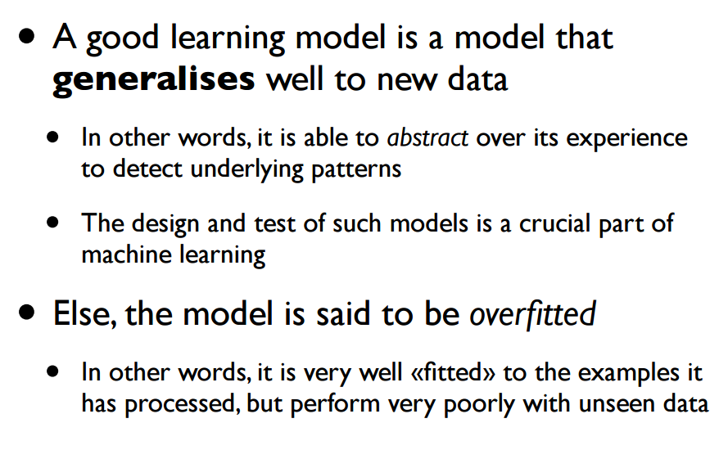

Slide 40
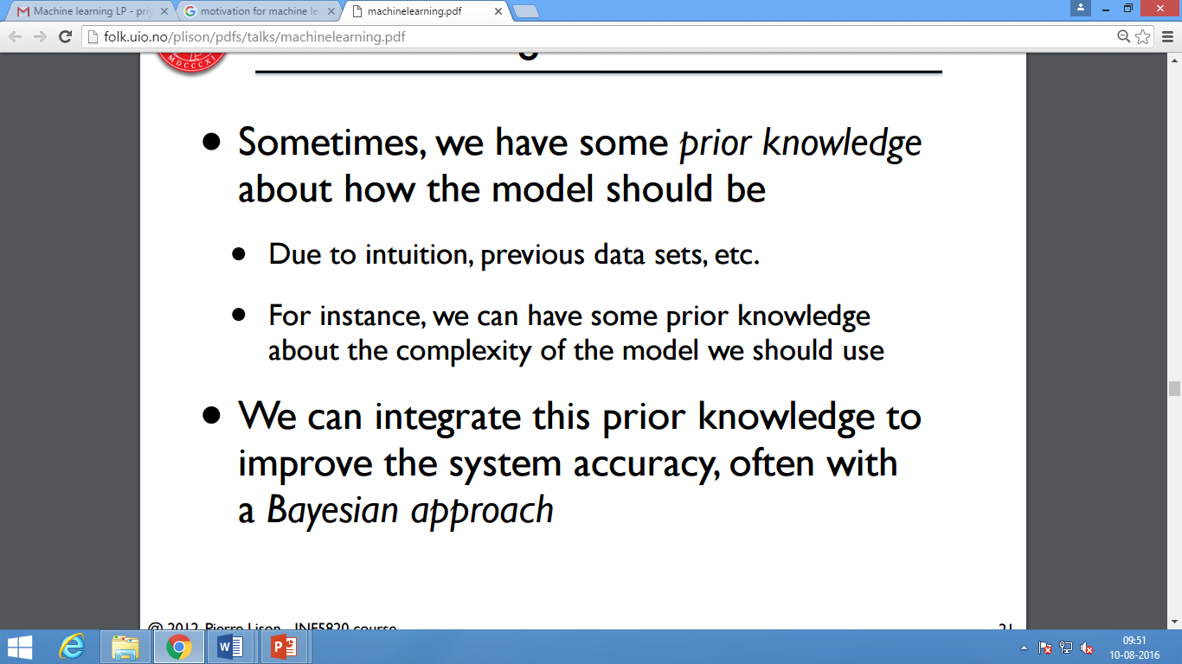

Slide 41
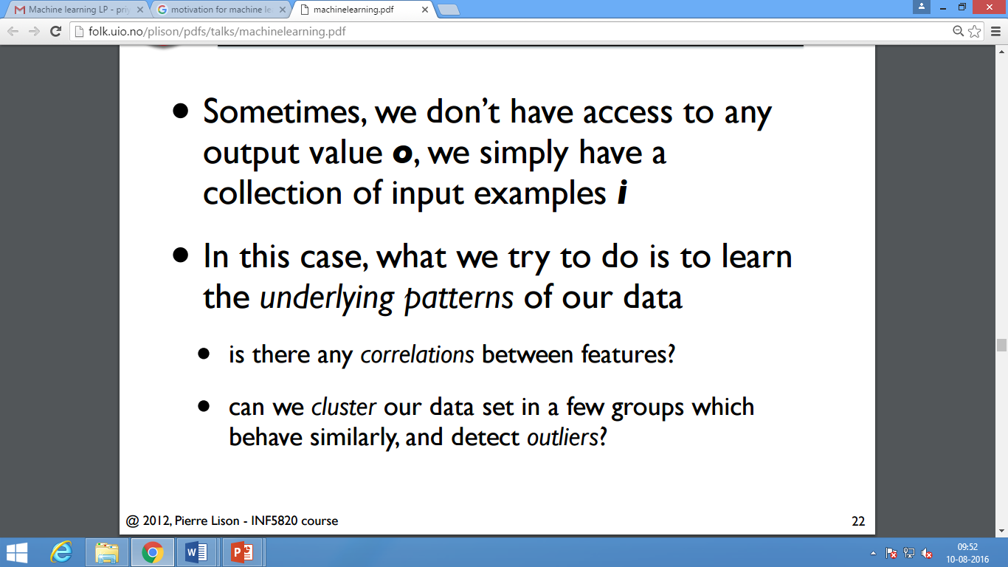
Unsupervised Learning

Slide 42
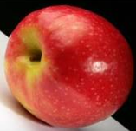
Unsupervised learning
Unsupervised learning: given data, i.e. examples, but no labels

Slide 43
Unsupervised learning applications
learn clusters/groups without any label
customer segmentation (i.e. grouping)
image compression
bioinformatics: learn motifs

Slide 44
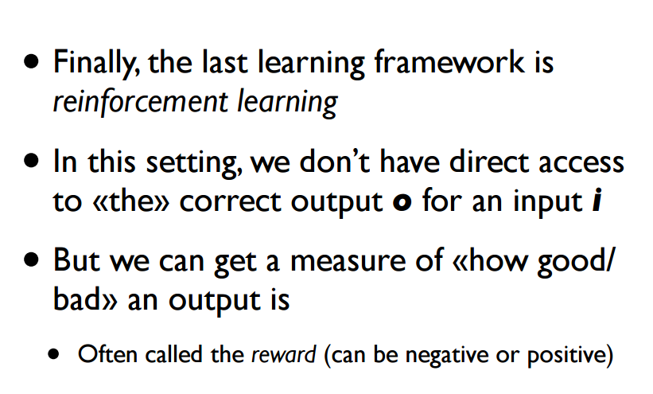
Reinforcement learning

Slide 45
Reinforcement learning
left, right, straight, left, left, left, straight
GOOD
left, straight, straight, left, right, straight, straight
BAD
left, right, straight, left, left, left, straight
18.5
left, straight, straight, left, right, straight, straight
-3
Given a sequence of examples/states and a reward after completing that sequence, learn to predict the action to take in for an individual example/state

Slide 46
Other learning
What data is available:
Supervised, unsupervised, reinforcement learning
semi-supervised, active learning, …
How are we getting the data:
online vs. offline learning
Type of model:
parametric vs. non-parametric

Slide 47
Dataset
How to Prepare Data For Machine Learning ?
Volume
Velocity
Veracity
Variety
Volatility
Authenticity of data available

Slide 48
Databases
Data repository
CSV
Image databases
Multimedia databases

Slide 49
Machine learning algorithms learn from data
It is critical that you feed them the right data for the problem you want to solve
Even if you have good data, you need to make sure that it is in a useful scale, format and even that meaningful features are included

Slide 50
Data Preparation Process
Step 1: Select Data
This step is concerned with selecting the subset of all available data that you will be working with.
There is always a strong desire for including all data that is available, that the maxim “more is better” will hold. This may or may not be true.
You need to consider what data you actually need to address the question or problem you are working on

Slide 51
Assumptions :
Make some assumptions about the data you require and be careful to record those assumptions so that you can test them later if needed.
The Process :
What is the extent of the data you have available? For example through time, database tables, connected systems.

Slide 52
What data is not available that you wish you had available? For example data that is not recorded or cannot be recorded. You may be able to derive or simulate this data.
What data don’t you need to address the problem? Excluding data is almost always easier than including data. Note down which data you excluded and why.
It is only in small problems, like competition or challenge datasets where the data has already been selected for you !!!!!!!!

Slide 53
Step 2: Preprocess Data
After you have selected the data, you need to consider how you are going to use the data. This pre-processing step is about getting the selected data into a form that you can work.
Three common data pre-processing steps are formatting, cleaning and sampling
Formatting: The data you have selected may not be in a format that is suitable for you to work with. The data may be in a relational database and you would like it in a flat file, or the data may be in a proprietary file format and you would like it in a relational database or a text file.

Slide 54
Cleaning: Cleaning data is the removal or fixing of missing data.
There may be data instances that are incomplete and do not carry the data you believe you need to address the problem.
These instances may need to be removed.
Additionally, there may be sensitive information in some of the attributes and these attributes may need to be anonymized or removed from the data entirely.

Slide 55
Sampling: There may be far more selected data available than you need to work with.
More data can result in much longer running times for algorithms and larger computational and memory requirements.
You can take a smaller representative sample of the selected data that may be much faster for exploring and prototyping solutions before considering the whole dataset.

Slide 56
It is very likely that the machine learning tools you use on the data will influence the pre-processing you will be required to perform.
We will likely revisit this step

Slide 57
Step 3: Transform Data
The final step is to transform the process data.
The specific algorithm you are working with and the knowledge of the problem domain will influence this step
You will very likely have different transformations of your pre-processed data as you work on your problem.

Slide 58
Three common data transformations are
Scaling
attribute decompositions
attribute aggregations . This step is also referred to as feature engineering.

Slide 59
Scaling: The pre-processed data may contain attributes with a mixtures of scales for various quantities such as dollars, kilograms and sales volume.
Many machine learning methods like data attributes to have the same scale such as between 0 and 1 for the smallest and largest value for a given feature.
Consider any feature scaling you may need to perform.

Slide 60
Decomposition: There may be features that represent a complex concept that may be more useful to a machine learning method when split into the constituent parts.
An example is a date that may have day and time components that in turn could be split out further.
Perhaps only the hour of day is relevant to the problem being solved.
Consider what feature decompositions you can perform.

Slide 61
Aggregation: There may be features that can be aggregated into a single feature that would be more meaningful to the problem you are trying to solve.
For example, there may be a data instances for each time a customer logged into a system that could be aggregated into a count for the number of logins allowing the additional instances to be discarded.
Consider what type of feature aggregations could perform.

Slide 62
What after data is ready?
An Introduction to Feature Selection and observations
Which features should you use to create a predictive model?
This is a difficult question that may require deep knowledge of the problem domain.
It is possible to automatically select those features in your data that are most useful or most relevant for the problem you are working on. This is a process called feature selection.

Slide 63
What is Feature Selection
Feature selection is also called variable selection or attribute selection.
It is the automatic selection of attributes in your data (such as columns in tabular data) that are most relevant to the predictive modeling problem you are working on.
feature selection… is the process of selecting a subset of relevant features for use in model construction

Slide 64
Feature selection is different from dimensionality reduction.
Both methods seek to reduce the number of attributes in the dataset, but a dimensionality reduction method do so by creating new combinations of attributes
where as feature selection methods include and exclude attributes present in the data without changing them.

Slide 65
The Problem The Feature Selection Solves
Feature selection methods aid you in your mission to create an accurate predictive model.
They help you by choosing features that will give you as good or better accuracy whilst requiring less data.
Feature selection methods can be used to identify and remove unneeded, irrelevant and redundant attributes from data that do not contribute to the accuracy of a predictive model or may in fact decrease the accuracy of the model.

Slide 66
Feature Selection Algorithms
There are three general classes of feature selection algorithms: filter methods, wrapper methods and embedded methods.
Filter Methods
Filter feature selection methods apply a statistical measure to assign a scoring to each feature.
The features are ranked by the score and either selected to be kept or removed from the dataset.
The methods are often univariate and consider the feature independently, or with regard to the dependent variable.
Example of some filter methods include the Chi squared test, information gain and correlation coefficient scores.

Slide 67
Wrapper Methods
Wrapper methods consider the selection of a set of features as a search problem, where different combinations are prepared, evaluated and compared to other combinations.
A predictive model us used to evaluate a combination of features and assign a score based on model accuracy.
The search process may be methodical such as a best-first search, it may stochastic such as a random hill-climbing algorithm, or it may use heuristics, like forward and backward passes to add and remove features.
An example if a wrapper method is the recursive feature elimination algorithm.

Slide 68
Embedded Methods
Embedded methods learn which features best contribute to the accuracy of the model while the model is being created. The most common type of embedded feature selection methods are regularization methods.
Regularization methods are also called penalization methods that introduce additional constraints into the optimization of a predictive algorithm (such as a regression algorithm) that bias the model toward lower complexity (less coefficients).
Examples of regularization algorithms are the LASSO, Elastic Net and Ridge Regression

Slide 69
Feature Selection Checklist
Do you have domain knowledge? If yes, construct a better set of ad hoc”” features
Are your features proportionate? If no, consider normalizing them.
Do you suspect interdependence of features? If yes, expand your feature set by constructing conjunctive features or products of features, as much as your computer resources allow you.
Do you need to prune the input variables (e.g. for cost, speed or data understanding reasons)? If no, construct disjunctive features or weighted sums of feature

Slide 70
Do you need to assess features individually (e.g. to understand their influence on the system or because their number is so large that you need to do a first filtering)? If yes, use a variable ranking method; else, do it anyway to get baseline results.
Do you need a predictor? If no, stop
Do you suspect your data is “dirty” (has a few meaningless input patterns and/or noisy outputs or wrong class labels)? If yes, detect the outlier examples using the top ranking variables obtained in step 5 as representation; check and/or discard them.

Slide 71
Do you know what to try first? If no, use a linear predictor. Use a forward selection method with the “probe” method as a stopping criterion or use the 0-norm embedded method for comparison, following the ranking of step 5, construct a sequence of predictors of same nature using increasing subsets of features. Can you match or improve performance with a smaller subset? If yes, try a non-linear predictor with that subset.

Slide 72
Do you have new ideas, time, computational resources, and enough examples? If yes, compare several feature selection methods, including your new idea, correlation coefficients, backward selection and embedded methods. Use linear and non-linear predictors. Select the best approach with model selection
Do you want a stable solution (to improve performance and/or understanding)? If yes, subsample your data and redo your analysis for several “bootstrap”.

Slide 73
Learning decision trees
Problem: decide whether to wait for a table at a restaurant, based on the following attributes:
Alternate: is there an alternative restaurant nearby?
Bar: is there a comfortable bar area to wait in?
Fri/Sat: is today Friday or Saturday?
Hungry: are we hungry?
Patrons: number of people in the restaurant (None, Some, Full)
Price: price range ($, $$, $$$)
Raining: is it raining outside?
Reservation: have we made a reservation?
Type: kind of restaurant (French, Italian, Thai, Burger)
WaitEstimate: estimated waiting time (0-10, 10-30, 30-60, >60)

Slide 74
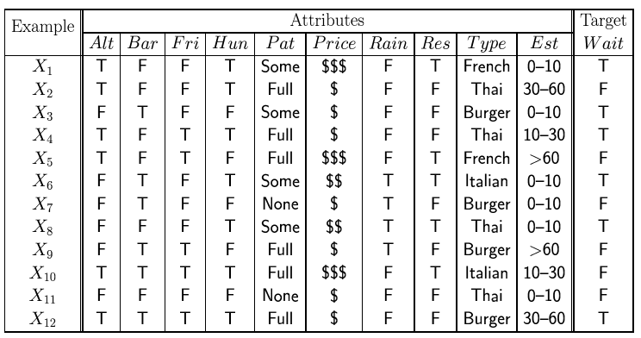
Attribute-based representations
Examples described by attribute values (Boolean, discrete, continuous)
E.g., situations where I will/won't wait for a table:
Classification of examples is positive (T) or negative (F)
The set of examples used for learning is called training set.

Slide 75
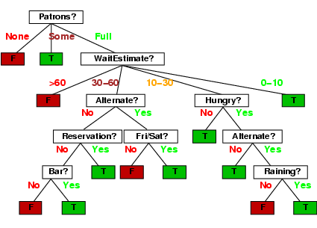
Decision trees
One possible representation for hypotheses
E.g., here is the “true” tree for deciding whether to wait:

Slide 76
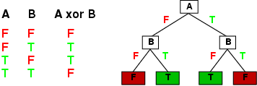
Expressiveness
Decision trees can express any function of the input attributes.
E.g., for Boolean functions, truth table row → path to leaf:
Trivially, there is a consistent decision tree for any training set with one path to leaf for each example (unless f nondeterministic in x) but it probably won't generalize to new examples
Prefer to find more compact decision trees

Slide 77
Quick Revision

Slide 78
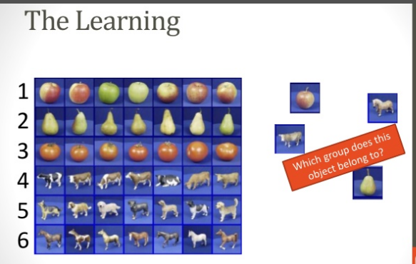

Slide 79
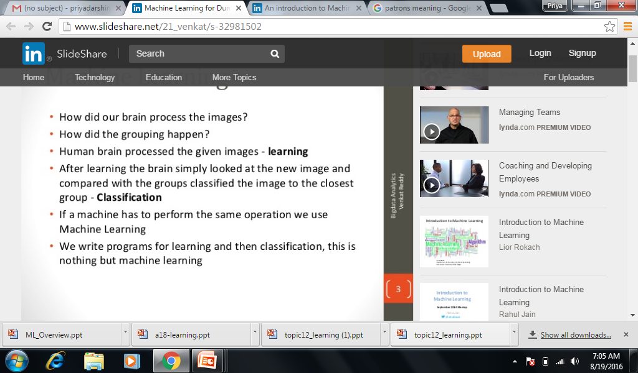

Slide 80
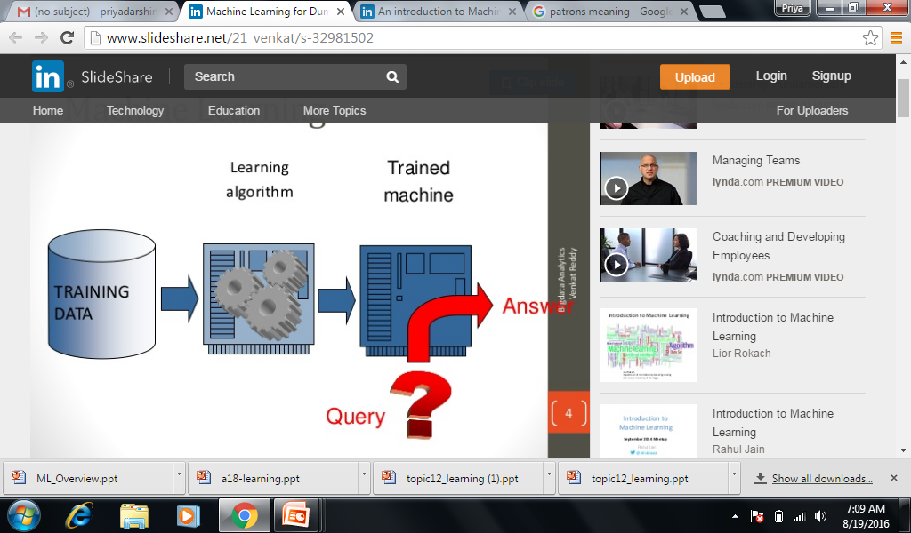

Slide 81
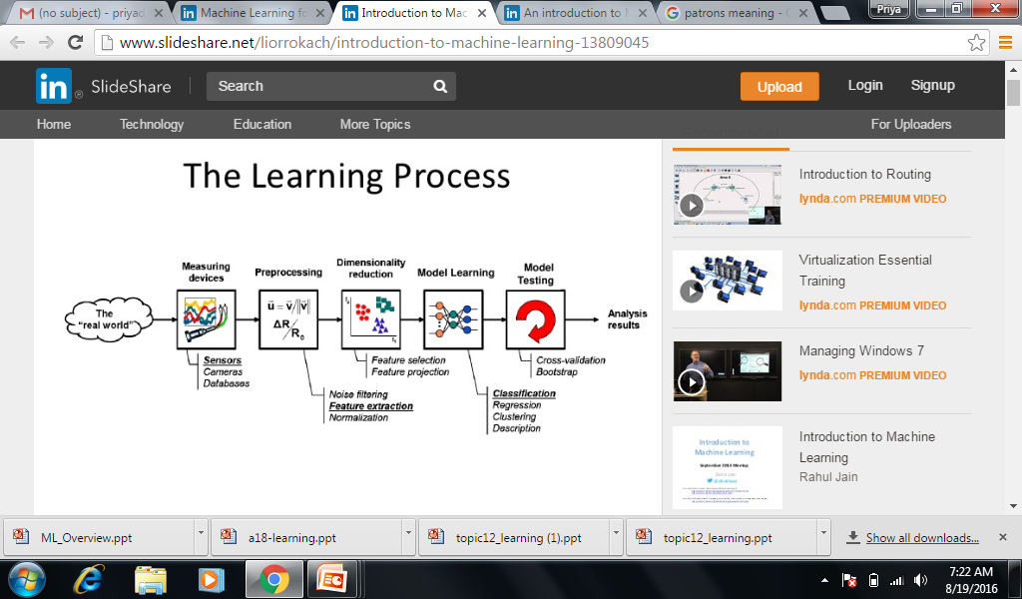

Slide 82






Types of Learning
Supervised learning: correct answer for each example. Answer can be a numeric variable, categorical variable etc.
Unsupervised learning: correct answers not given – just examples (e.g. – the same figures as above , without the labels)
Reinforcement learning: occasional rewards
M
M
F
F
M
F

Slide 83
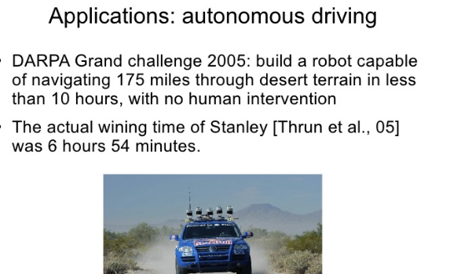

Slide 84
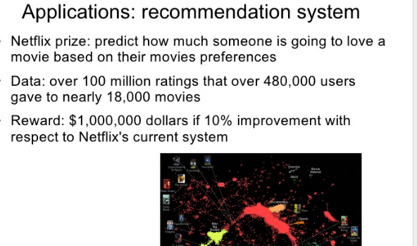

Slide 85


Slide 86
Formal definition of ML
“A computer program that learns from experience E with respect to some task T and some performance measure P, if its performance on T, as measured by P, improves with experience E.” -- Tom Mitchell, Carnegie Mellon University

